Slide 1

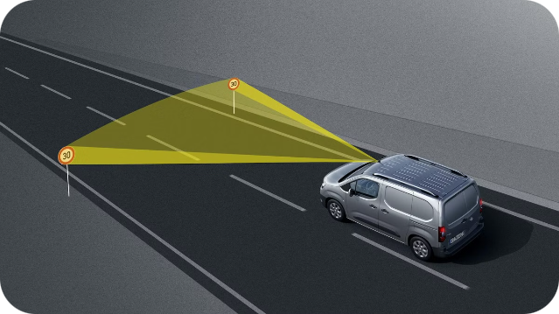
Voice-Based Traffic Sign Recognition
by:
Syed Ali
Vivekavardhan Berila
Abdul Rehman
Hayath Allabakash
Yatish Nayan

Slide 2

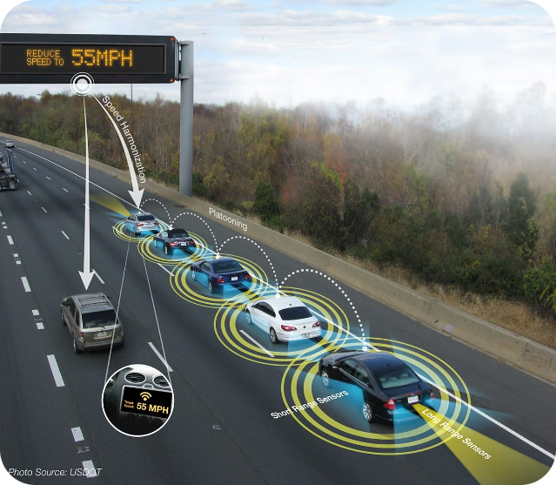
Introduction
“Voice-Based Traffic Sign Recognition," focuses on developing a deep learning-based system capable of recognizing traffic signs and providing real-time voice feedback to users. The system is designed to enhance road safety and accessibility, especially for drivers and pedestrians who may require additional assistance in interpreting traffic signs.
The primary objective is to build a robust traffic sign recognition model using Convolutional Neural Networks (CNNs) and integrate it with a voice output system. The system is intended to be deployed as a web application, allowing users to upload images of traffic signs and receive immediate voice feedback on the sign's meaning.

Slide 3

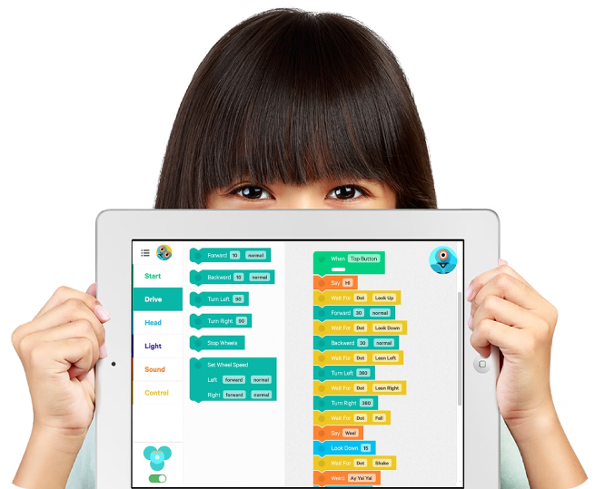
Technologies Used
Python
TensorFlow/Keras
Flask
Numpy
Pandas
OpenCV

Slide 4

Problem Statement
Challenges in Traffic Sign Recognition
Proposed Solution
Environmental factors like lighting, weather, and image quality can impact recognition accuracy.
Combining deep learning for sign recognition with speech synthesis for audio feedback addresses these challenges.
Real-time processing is essential for autonomous vehicles to make quick and accurate decisions.
Accessibility solutions are needed to assist visually impaired drivers.

Slide 5
Methodology Overview
1
Image Preprocessing
Images are prepared for the model through resizing, normalization, and grayscale conversion.
2
Model Training
The CNN architecture, training process, and hyperparameters are defined and optimized.
3
Data Augmentation
Techniques like rotation, flipping, zooming, and brightness adjustment enhance dataset diversity and robustness.
4
Speech Recognition
Recognized signs are converted to text and then to voice using speech synthesis technology.
5
Web Application
A Flask-based web application is built for image upload, prediction display, and voice feedback.

Slide 6
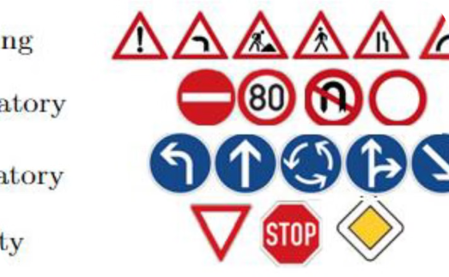
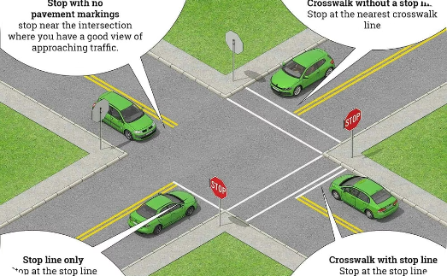

Image Preprocessing
Resizing
Normalization
Grayscale Conversion
Images are standardized to match the CNN model's input requirements, ensuring consistency.
Pixel values are scaled to a range (e.g., 0 to 1) for improved model performance and stability.
If color information is not crucial, images are converted to grayscale to reduce complexity.

Slide 7

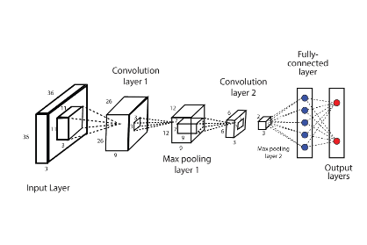
Model Architecture
Convolutional Layers
Extract hierarchical features from input images using convolutional filters.
Pooling Layers
Reduce spatial dimensions of feature maps to retain essential features and decrease complexity.
Fully Connected Layers
Perform classification based on features extracted by convolutional and pooling layers.
Activation Functions
Introduce non-linearity and improve learning (e.g., ReLU).

Slide 8






Data Augmentation
Rotation
Simulates different viewing angles to improve the model's ability to recognize signs from various orientations.
Flipping
Adds diversity by creating mirrored versions of images.
Zooming
Enhances the model's ability to recognize signs at different distances.
Brightness Adjustment
Helps the model adapt to varying lighting conditions.

Slide 9


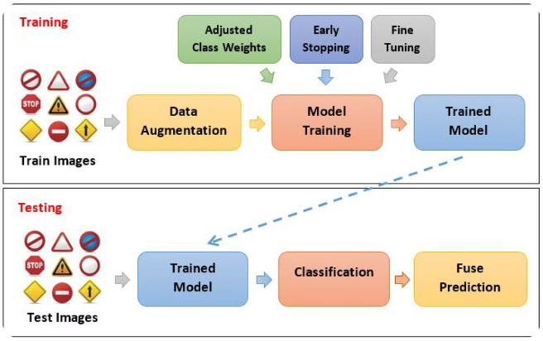


Model Training
Dataset
The German Traffic Sign Recognition Benchmark (GTSRB) or similar dataset is used for training.
Parameters
Epochs, batch size, and optimizer (e.g., Adam, SGD) are defined for the training process.
Performance Metrics
Accuracy and loss values are used to evaluate the model's performance during training.

Slide 10

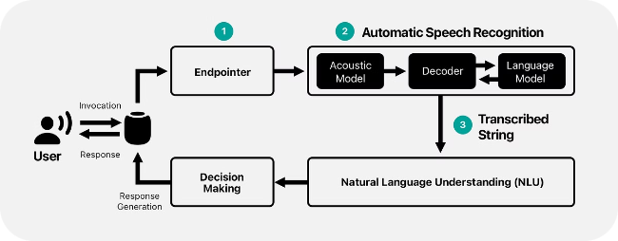
Speech Recognition Integration
1
Tools and Libraries
Libraries like Google Speech Recognition API are used for converting text to speech.
2
Process
Recognized traffic signs are converted into text and then into audio messages.
3
Flow
The traffic sign recognition output is processed into voice feedback.
4
Example
The system recognizes a "Stop" sign and outputs the corresponding voice message.

Slide 11

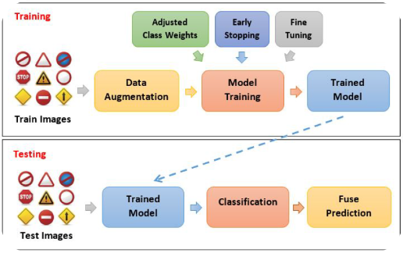
Flask Web Application
Image Upload
Prediction Display
Voice Output
Users can upload images of traffic signs through a simple interface.
The application displays the recognized sign on the web interface.
The application uses a speech synthesis engine to provide audio feedback for the recognized signs.

Slide 12





System Workflow
Image Input
Users upload an image of a traffic sign.
Preprocessing
The image is resized and converted into a format suitable for the CNN model.
CNN Model
The preprocessed image is fed into the CNN model, which identifies the traffic sign.
Speech Synthesis
The recognized traffic sign is converted into an audio message.
Voice Output
The application plays the audio message, providing voice feedback.

Slide 13
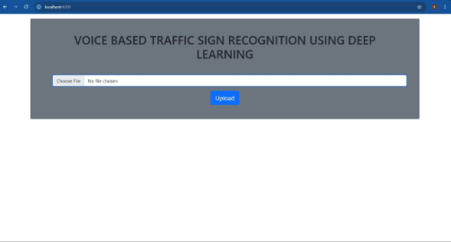
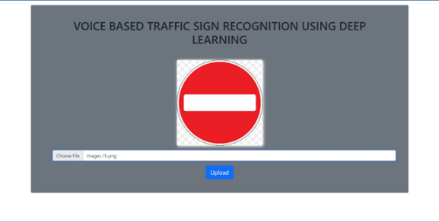
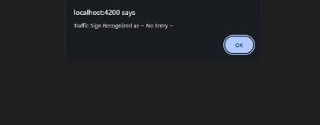
Results
Flask Web page
Uploading an image
Predicting Traffic Sign and giving voice advice

Slide 14

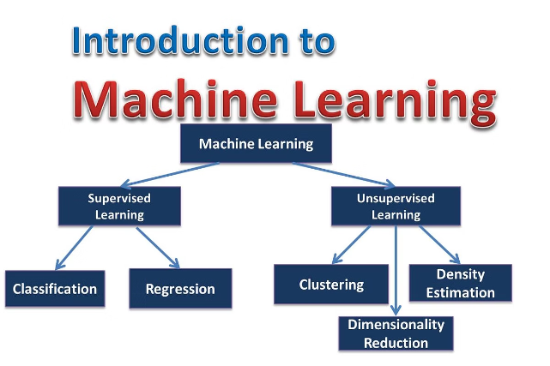
Challenges Faced
1
Model Accuracy
The initial model struggled to achieve high accuracy on certain traffic signs, particularly those with similar features.
2
Integration Difficulties
Integrating the speech recognition engine with the traffic sign recognition model required careful consideration of audio formatting and timing.
3
Dataset Variability
The training dataset contained images captured under various lighting and weather conditions, which impacted model performance.

Slide 15


Future Work
Enhanced Dataset
1
Expanding the training dataset to include a broader range of traffic signs, varying lighting conditions, and more diverse scenarios will enhance the model's generalizability and robustness.
2
Real-Time Processing
Improving the system's real-time processing capabilities is a critical area for future development. This will enable seamless integration into real-world applications such as driver assistance systems.
Additional Languages
3
Expanding the system to support multiple languages for voice feedback will enhance accessibility and inclusivity for a wider range of road users.
4
Integration with Vehicles
Exploring integration with vehicle systems presents an exciting opportunity to enhance safety and driver assistance. This could involve incorporating the system into autonomous vehicles or providing real-time alerts to drivers.

Slide 16


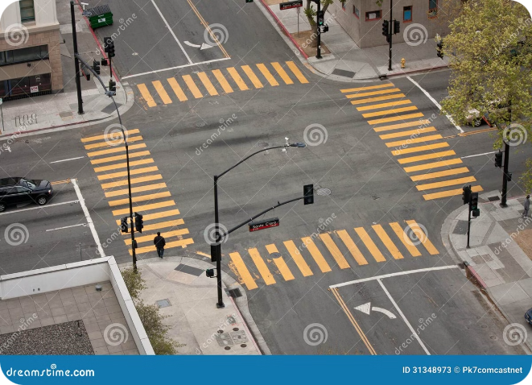


Conclusion
Project Summary
The project successfully developed a deep learning-based traffic sign recognition system equipped with voice feedback, improving accessibility and safety for road users.
Impact
This system demonstrates a practical application of deep learning in transportation, offering potential integration with autonomous vehicles and driver assistance systems, enhancing safety and accessibility.
Future Directions
The system can be expanded to recognize a wider range of traffic signs, adapted for use in various countries and environments, and integrated with vehicle systems for real-time applications.

